Slide 1
FastTrack for Dynamics 365
Solution Blueprint Workshop
Created On: 18/03/2021

Slide 2
Solution Blueprint Workshop Agenda
Agenda
Understand your Program Design, provide best practices review, highlight any risks and gaps in the plan. Product roadmap and release alignment.
Program Strategy
Test Strategy
Attendees: Key stakeholders from the customer and partner teams. Solution architects, functional and technical leads are mandatory.
Requirements: Solution Blueprint WS templates filled out. High level Solution Architecture completed. Project plan and team roles defined.
Business Process Strategy
Application Strategy
Data Strategy
Integration Strategy
Intelligence Strategy
Security Strategy
ALM Strategy
Environment & Capacity Strategy

Slide 3
Introductions

Slide 4
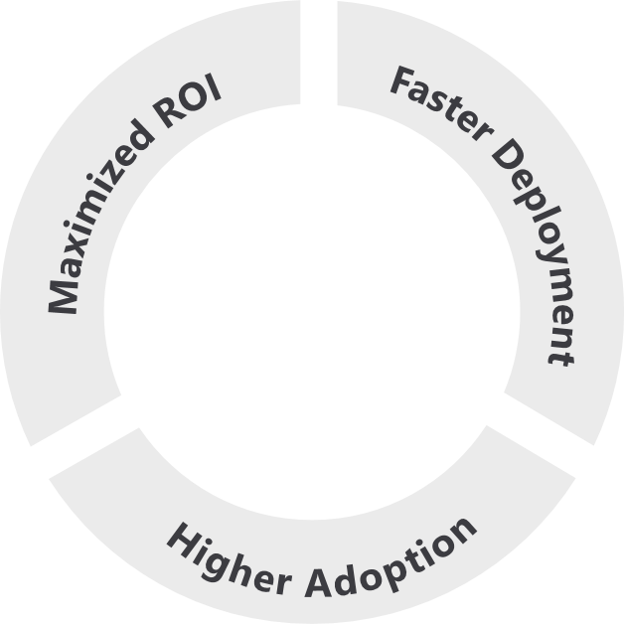
Based on Success by Design
The Dynamics 365 engineering team brings you the learnings and experiences from 3000+ cloud deployments through Success by Design.
Success by Design (SbD) is the prescriptive guidance - approaches & recommended practices - for designing, building and deploying a Dynamics 365 solution.
It is grounded in fundamentals of good solution architecture and design, product capabilities, and proven approaches to business process transformation and implementation.
Designed around three core principles:
2.2x
higher usage of Dynamics 365
Early Detection
Proactive Guidance
Predictable Success
Notes:
Source: The data point of 2.2x higher usage of Dynamics 365 is based on data analysis by the FastTrack team on the MAU of FastTrack tenants vs non-FastTrack tenants for above 500 seats.

Slide 5
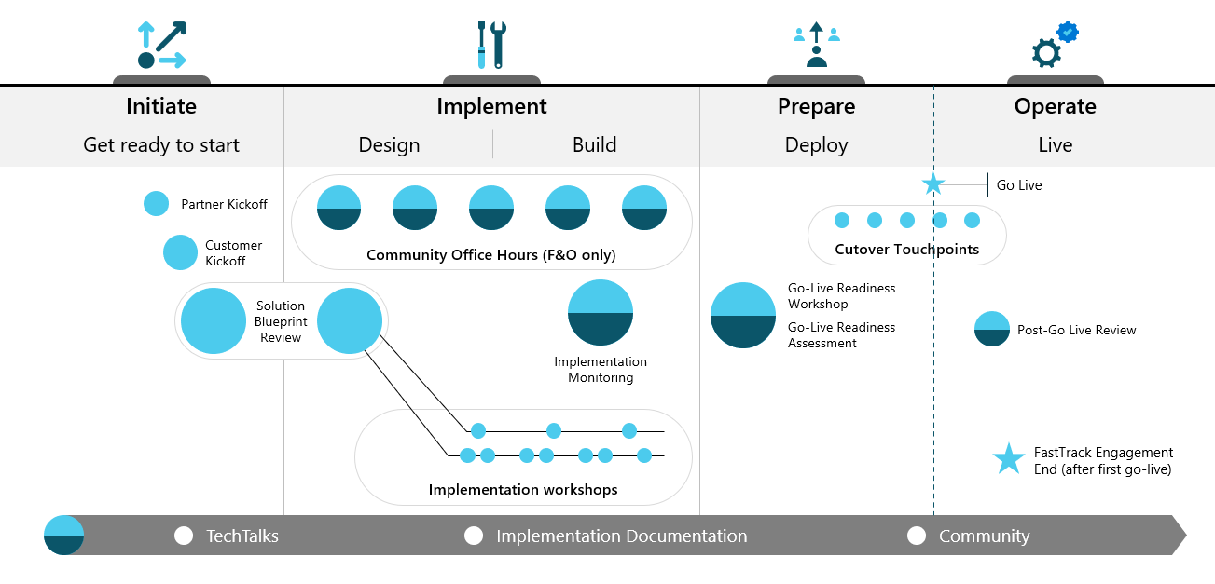
Initiate-Solution Blueprint Workshop
Refine your vision, identify and prioritize business scenarios, and collaborate with key stakeholders to plan for successful rollouts at your own pace.
High Level Architecture and Solution
Project Plan and Governance Model
Application Lifecycle Management and Release Plan

Slide 6
The Role of FastTrack
In Scope
Review the answers provided
Provide findings and recommendations following the workshop presentation
Provide alternatives to product gaps identified
Highlight technical and project risks and issues (including unrealistic product expectations)
Point out gaps in the solution or project structure that can result in an unsuccessful implementation
Out of Scope
Create a solution architecture based on findings
Decide on solutions that best fit gaps identified
Code review
Provide training on product features (user or administrative)
Create comparison between ISV solutions

Slide 7
Instructions for Customer and Partner
How to fill this PowerPoint document
Complete each slide providing the required information
Skip slides that are not applicable to your project
Extend topic area slides to capture the required information if needed. Do not hesitate to paste your own slides.
Reach out to your FastTrack SA if you have questions on the format or content
Send completed deck back to the FastTrack SA 5 business day before the scheduled Solution Blueprint workshop.

Slide 8
Program Strategy

Slide 9
Program Strategy
Brief overview of business
[Add an overview of your business]

Slide 10
Program Strategy
Business Challenges
[What are the current business challenges that this Program will help address?]

Slide 11
Program Strategy
Project goals and objectives
[Add goals and objectives]

Slide 12
Program Strategy - Solution Scope
Main Functional Areas
Sales
Customer Service
Field Service
Project Operations
Marketing
Finance
Commerce
HR
…
Phase & Timeline
Project start: August 2016
Current Project Phase: Design
Target go-live: January 2017
Number of users: 185
Business
Industry: Manufacturing
Business Model: B2B vs B2C
Geos: US and Canada
Default Language: EN-US
Default Currency: USD
Data center: US East
185
Total User Count
2
Geos
3
Project Phases
6
Integrations internal/external
1/4
Total Tenants/ Environments
1
ISV solutions

Slide 13
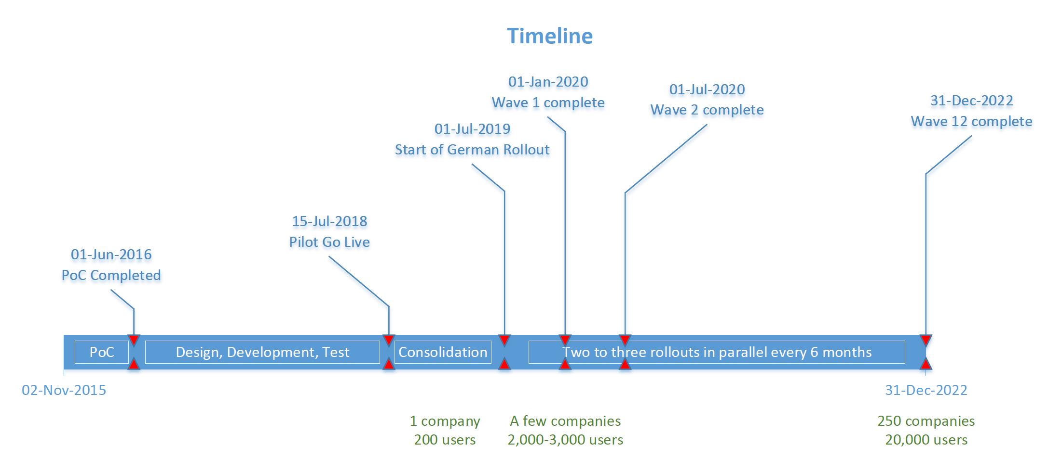
Program Strategy
Project Timeline

Slide 14
Program Strategy
Customer, Partner and Microsoft teams
Customer and Partner Program Team
Customer Business Sponsor:
Customer Product Owner:
Project Manager:
Solution Architect(s):
Tenant Administrator(s):
Data Migration Owner(s):
Training & Adoption:
Microsoft Team
Sales Team:
Account Executive:
FastTrack SA:
CSM:
CSAM (TAM):
Microsoft Partner Manager:

Slide 15
Test Strategy

Slide 16
Test Strategy
Test Plan, Non-Functional requirements in the testing strategy
Test Plan
Performance Test
Identification of Metrics & Input into Design
Performance and scalability goals

Slide 17
Business Process Strategy

Slide 18
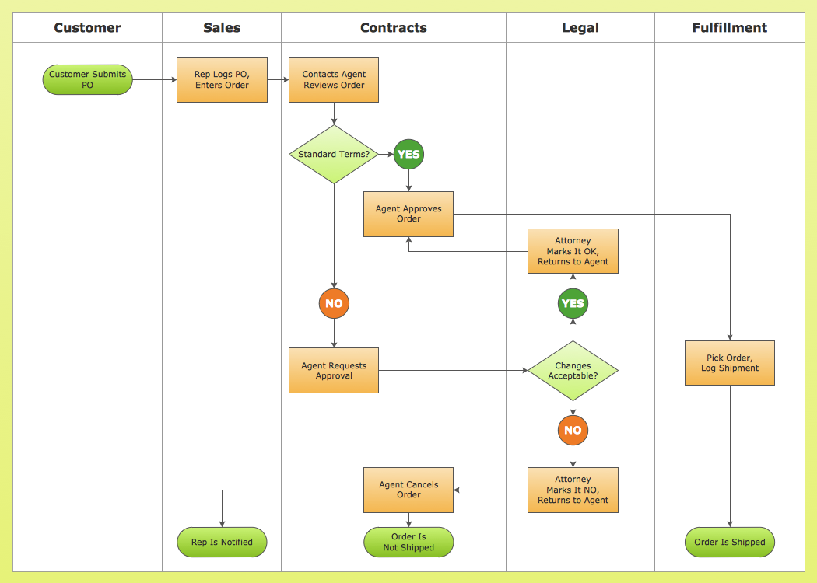
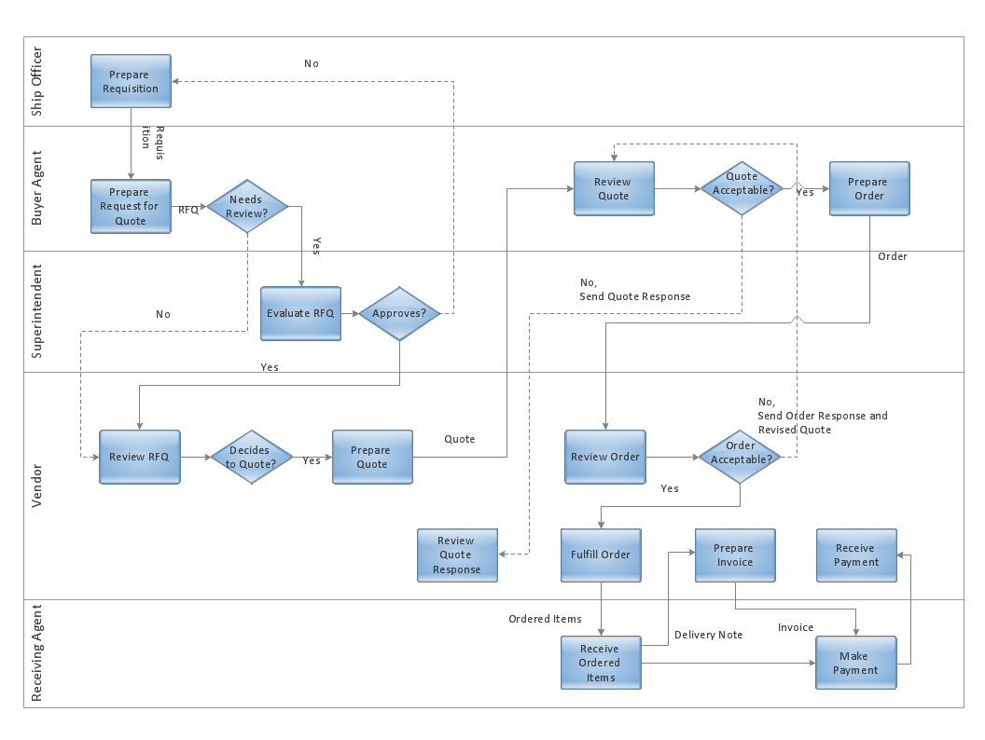
Business Process Strategy
Describe the 3-5 main business processes and personas
Dynamics 365 App: Finance / Sales / Customer Service / Project Operations / Field Service / Marketing / …
Process: <Process Name>, High level Description
Key Personas: Ex: Seller, Sales Mgr. , etc.
A blueprint that provides a conceptual view of the business process being implemented.
Example: The sales process, Field Service process, or custom regulatory process, etc.
💡 Check the Workshop Guide pptx for App related examples
Notes:
=========================
Why are we asking this information?
To be able to have a detailed view of the business processes being implemented:
Please include the following details:
For Sales:
Sales Process end-to-end (including sales channels integration)
For Customer Service:
Case lifecycle (including support channels integration, case escalations, SLA’s, stakeholders, KPI’s, etc.)
For Field Service:
Work Orders lifecycle (including channels integration, service and billing accounts, assets, agreements, service locations, currency and pricing, incident types and duration, characteristics, billing)
For Project Service Automation (See slides in the appendix for examples):
Sales Process end-to-end
Pricing strategy
Resource Assignment Process
Time Entry and Expenses Approval
Invoicing Process and volumes
For Marketing:
Customer jourvey end-to-end (including, Marketing Emails, Marketing pages and Forms, Segments, Leads, Events, Portals, Social Media)
=========================
What we’ll do with this information?
Better understand the architecture being built.
=========================
FAQ:

Slide 19
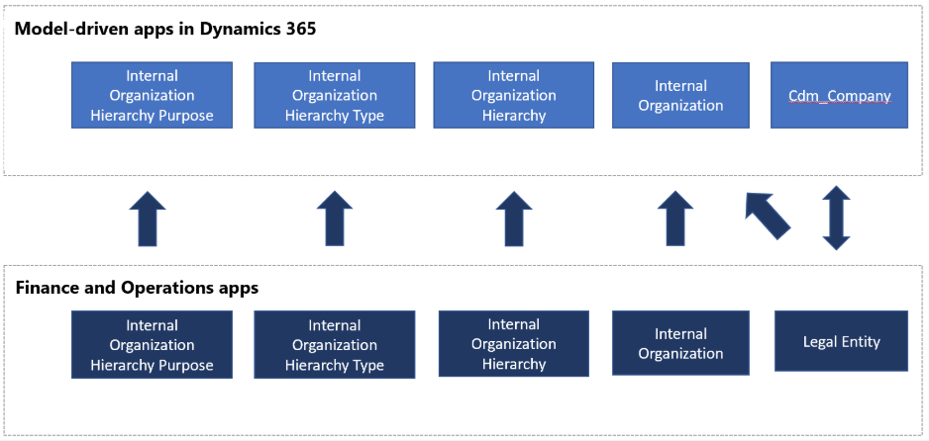
Business Process Strategy
Describe the Dataverse/F&O Integration flow
Dynamics 365 Apps: Sales / Customer Service / PSA / Field Service / Marketing
Process: <Process Name>
A blueprint that provides a conceptual view of the data integration data flows being implemented.
Example: The sales process, Field Service process, or custom regulatory process, etc.
💡 Check the Workshop Guide pptx for App related examples
Notes:
=========================
Why are we asking this information?
To be able to have a detailed view of the data flows being implemented:
Please include the following details:
Dynamics 365 Apps and Finance & Operations
Field Service to Finance & Operations
PSA to Finance & Operations
Data Integrator vs Dual Write
OOB Templates vs Custom Templates
Gaps
Additional relevant topics:
How many legal entities are part of this integration?
What are the standard vs custom integration flow?
How is number sequencing handled across systems?
What's the trigger / filter for data sync?
Are there any identified Gaps?
=========================
What we’ll do with this information?
Better understand the architecture being built.
=========================
FAQ:

Slide 20
Application Strategy

Slide 21
App Strategy - Dynamics 365 App Usage
Apps (* = live) | Insights | Reporting | Survey | Dataverse/F&O Integration | OOB/Custom MDA? | Flow vs Legacy WF | Embedded Canvas App
Sales | Sales Insights | PowerBI/Other | Customer Voice | DI/DW/Logic Apps | Sales Hub or custom | Both | Yes/No
Customer Service (CS) | CS Insights
Project Operations
Field Service
Marketing |  |  | Customer Voice
Customer Insights
Product Insights
Finance |  |  |  |  | N/A |  | N/A
Fraud Protection |  |  |  |  | N/A |  | N/A
Human Resources |  |  |  |  | N/A |  | N/A
Supply Chain Management |  |  |  |  | N/A |  | N/A
Commerce |  |  |  |  | N/A |  | N/A
* Delete what is not applicable
Notes:
=========================
Why are we asking this information?
To be able to have a better understanding of the app that are or will be used.
=========================
What we’ll do with this information?
Better understand the architecture being built.
Provide recommendations for new apps/features available
Align architecture with roadmap
=========================
FAQ:
Please identify if any of the Apps are already live, for example, if you’re implementing Sales App and Finance is already live, please add (Finance *) a star after Finance.
Remove any app, insights, etc. that are not part of your architecture.

Slide 22














App Strategy – Persona based Apps for Dataverse
Provide information on which of the examples below describes your app usage strategy.
vs
Unique App
Multiple Apps
App Driven
Unique or multiple per App
Sales
Customer Service
Field Service
Marketing
Project Service Automation
Role/Persona Driven
Salesperson
Sales Manager
Field Engineer
Support Engineer
System Admin
Security
Mobile

Slide 23
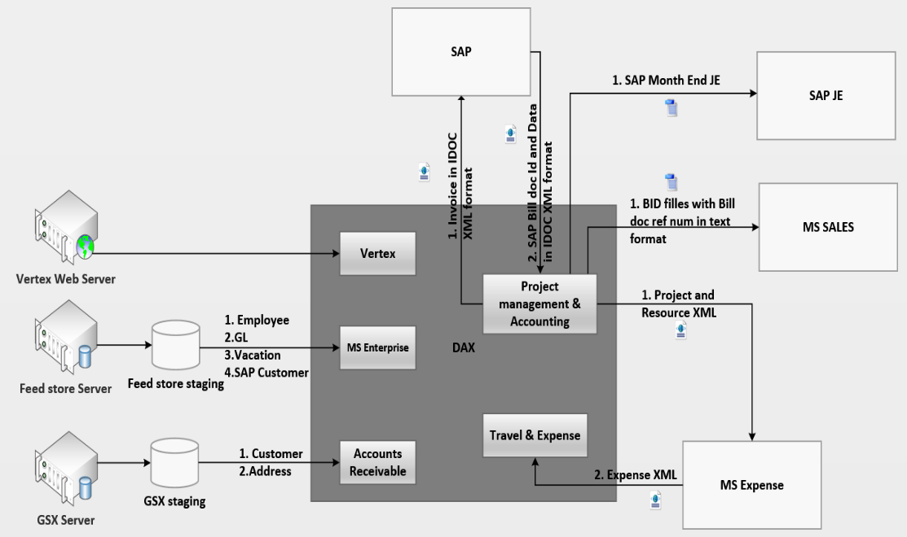
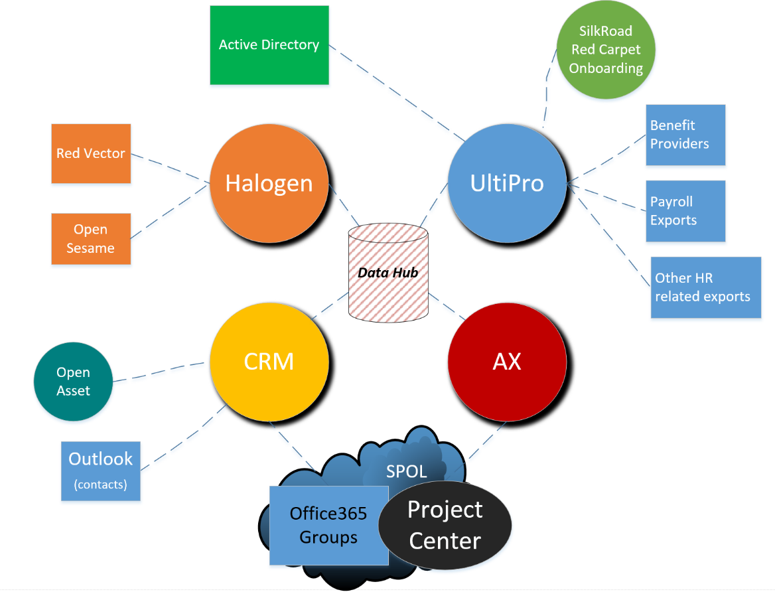
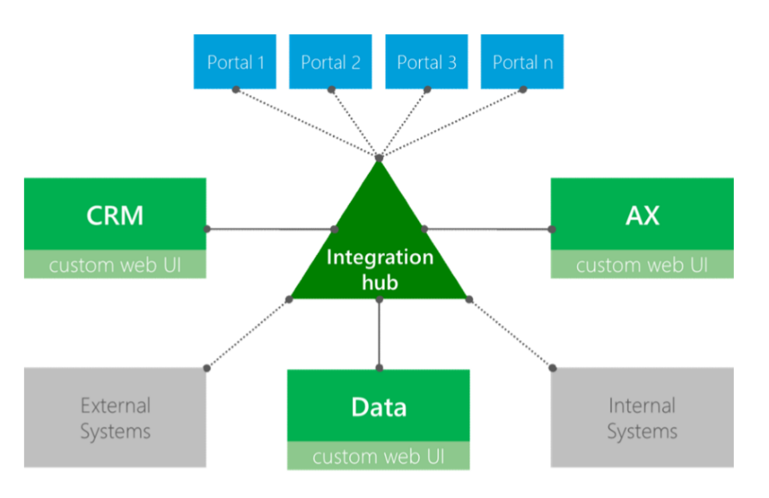
App Strategy - Solution Architecture
Blueprint, architecture diagrams, functional overview…
A blueprint that provides a conceptual view of the architecture being built
The view should cover system landscape and key interfaces, such as integrations with other systems

Slide 24
App Strategy - ISV Solutions/Add-ons
Describe all ISV solutions planned
ISV Name | Description | Risk | Company | Complexity | Available in AppSource
ClickDimensions | Marketing Automation | ISV has used it extensively, and implementation team has the experience to deploy it | Click Dimensions | 200 | Y/N
Legend:
100 – Low Complexity
200 – Medium Complexity
300 – High Complexity
400 – Very High Complexity

Slide 25
App Strategy - Complex customizations (level 300 and above)
Detail all complex customizations involving custom developments
Purpose | Type (Plugin, JavaScript, PCF, Custom Actions, X++) | Justification | Execution time & Frequency | Complexity
Plugin for complex calculations | Plugin | ….. | 200 ms, 15 executions per hour | 400
Phone number formatting | JavaScript | Respecting regional formatting | Every time phone number field is updated | 300
💡 Legend
100 – Out-of-box Configuration (ex: form redesign)
200 – No code Customization (ex: Business Rules, Flow)
300 – Some level of custom code within CDS platform (ex: Plugins, Jscript)
400 – Custom code involving integrations (ex: Integrations with external systems, Azure, etc.,)
Notes:
"In the SBR Stage we expect the Partner/Customer to highlight the areas that they will customize heavily, probably involving code based on the gaps identified. Understand the final design may not be there during SBR but surfacing these earlier in SBR will help create awareness and also let the SA focus on these areas through out the engagement.
It should be made very clear that any areas where partner plans to do level 300/400 customizations should be discussed with FT SA, so we can assess if something in roadmap will address this if not the customization being done is scalable and fits into the platform extension framework. Ex: PCF or a custom connector for Power Automate "

Slide 26
App Strategy - Gaps & Risks
Describe identified product gaps & project risks

Slide 27
App Strategy - Transaction Volumes
Outline your 24h operations schedule
See Solution Blueprint Template.xlsx
Notes:
Note that this is not to list out all entity changes but key deviations from standard CDM where you use a custom entity when OOB is present or when you repurpose or don’t use OOB attributes. Ex: Use a custom Opportunity/product entity. Use case title field to capture case number etc.
Deviations from CDM can have a severe impact on adoption on new capabilities in future

Slide 28
Data Strategy

Slide 29
Data Strategy - Data Model Customizations
Highlight areas where you will have to create new entities to replace standard entities and deviate from CDM, repurposed or recreated CDM attributes
See Solution Blueprint Template.xlsx
Notes:
Note that this is not to list out all entity changes but key deviations from standard CDM where you use a custom entity when OOB is present or when you repurpose or don’t use OOB attributes. Ex: Use a custom Opportunity/product entity. Use case title field to capture case number etc.
Deviations from CDM can have a severe impact on adoption on new capabilities in future

Slide 30
Data Strategy
Approach & Plan for Data Migrations
See Solution Blueprint Template.xlsx

Slide 31
Data Strategy
Master Data Management, Data sharing across legal entities, Configuration Management, Cutover plan
[Provide detailed information on this topics if applicable to your Program.]

Slide 32
Data Strategy
Data Retention and Data Archiving Strategy
[Provide detailed information on this topics if applicable to your Program.]

Slide 33
Integration Strategy

Slide 34
Integrations Strategy
Describe all data interfaces planned
See Solution Blueprint Template.xlsx

Slide 35
Intelligence Strategy

Slide 36
Intelligence Strategy
Reporting and Analytics Requirements
Operational Reporting and Insights
Strategic organizational and executive reporting
Data warehousing Strategy
Artificial Intelligence

Slide 37
Security Strategy

Slide 38
Security Strategy
Identity, Active Directory, security
Federation Setup / Single sign-on
Multi tenant & Cross Tenant Access
Integration Identity and Service Accounts
AD Access Management

Slide 39
Security Strategy
Roles, Field Level / XDS Policy

Slide 40
ALM Strategy

Slide 41
ALM Strategy
Describe your strategy to deploy releases and hotfixes from development to production
ALM Environments
Release Process
Build & Deployment Process
Source Control & Configuration Management
ISV ALM Strategy

Slide 42
Environment & Capacity Strategy

Slide 43
Environment Strategy
Tenants, Environments, Updates, Monitoring…
Tenant & Geo Strategy
Monitoring & Notification Management
Platform Release Process & Updates
ALM Alignment
Service Levels
Regulations & Compliance

Slide 44
Capacity Strategy
Aligning product, user licenses & add-ons to technical and business requirements
Have you completed the licensing processes?
Impact of your architecture and design on licensing
Integration related licensing & cost, outside of Dynamics 365 is accounted for (ex. Logic Apps, Azure Functions, ADL, SQL, etc.)
API Limits and Capacity are taken into licensing consideration based on data volumes and load
Notes:
The intention of this slide is not to have a deep licensing conversation but to ensure that the
-> Bill of Material for the Project is kept up-to date and there is a process to work with MS licensing exec and SSP
-> Architecture takes into consideration the current licenses procured. Ex: No consideration for API add-ons , Lower Sales SKU with no insights etc
Customer should work with the licensing teams and the licensing partner to discuss this in the context of their EA. This is not intended for any commercial conversations but just a checkpoint to ensure solution is not bring built in complete isolation of what customer is entitled to.

Slide 45
Q & A Session

Slide 46

Disclaimer
© 2021 Microsoft Corporation. All rights reserved. Microsoft, Microsoft Dynamics, Office 365, Windows, and other product names are or may be registered trademarks and/or trademarks in the U.S. and/or other countries. The information herein is for informational purposes only and represents the current view of Microsoft Corporation as of the date of this presentation. Because Microsoft must respond to changing market conditions, it should not be interpreted to be a commitment on the part of Microsoft, and Microsoft cannot guarantee the accuracy of any information provided after the date of this presentation. MICROSOFT MAKES NO WARRANTIES, EXPRESS, IMPLIED OR STATUTORY, AS TO THE INFORMATION IN THIS PRESENTATION

Slide 47
Appendix

Slide 48
Power Apps Portals Blueprint
Please introduce a description of the main functionality you are going to implement within the portal scope.
Are you currently using another Portal or CMS platform? What users are going to access the Portal? Anonymous access? Internal/External Users? Do you need to match/migrate users?
Portal User or Page Load Capacity Planned/Licensed?
Portal Template | Y/N | Portal Template | Y/N | Portal Template | Y/N
Customer Self-Service | Y | Employee Self-Service |  | Portal Custom Blank / Starter Portal
Partner Portal |  | Community Portal |  | Customer Portal
Feature | Y/N | Feature | Y/N | Feature | Y/N
Multi-Language Support | Y | Field Service Integration |  | Web Forms / Multi Step Forms
Knowledge Management |  | SharePoint Integration |  | Entity Lists / Entity Forms
Support/Case Management |  | Power BI Integration |  | Theming / Styling
Forums |  | Azure Storage integration |  | Ideas / Polls
Faceted/Global Search |  | Traffic Analyzer / App Insights |  | Blogs
Profile Management |  | External Identity Providers |  | Integration to other APIs/Data
Notes:
=========================
Why are we asking this information?
This information will give us an idea of the scope of your field service implementation plans.
=========================
What we’ll do with this information?
During the Solution Blueprint Review workshop, we will use this information to discuss in-scope functional areas of the of your intended field service solution. Helping to ensure that you have awareness of the variety capabilities the application offers, and have included them in your short, and long, term plans where relevant.
=========================
FAQ:
Key things
Right template is chosen
Potentially low used features which have little investment , Any recommendation - RKB will support the recommendation based on answers
Scenario

Slide 49
PSA: Sample Processes
Notes:
=========================
Why are we asking this information?
This information is important to understand how the PSA Sales Process will be implemented.
The Sales Process end-to-end should be an overview of the process from the moment the Salesperson has the Opportunity until the Project is sold to the customer. Are they using Opportunities > Quote > Order (Project Contract)? At what point will the Project be created? Who will create the Project Plan? Will the price come from an estimation on the Project Plan or negotiated by the Salesperson up-front?
Pricing strategy should detail how will you manage the Cost and Sales price of the resources. How many currencies will there be? How often will the Price Lists change? What dimensions will be used for Pricing? Will Markups and Markdowns be used?
=========================
What we’ll do with this information?
Get details on how Pricing of Resources will be done in PSA.
=========================
FAQ:

Slide 50
PSA: Sample Processes
Notes:
=========================
Why are we asking this information?
This information is important to understand how the Resource Assignment will be done for the Project.
For Resource Assignment Process should provide details on how Resources will be assigned to the Project Tasks in a Project. Will they be directly assigned by the Project Manager or requested to a Request Manager? Will there be an Approval process for assignments?
For Time Entry and Expenses Approval should provide details on the submission and approval process. Will both be used? If not, will they be handled by another system? How?
=========================
What we’ll do with this information?
Understand whether there will be any customization done to the Resource Assignment Process.
=========================
FAQ:

Slide 51
PSA: Sample Processes
Notes:
=========================
Why are we asking this information?
This information is important to understand how the Invoicing will be implemented.
For the Invoicing Process we are expecting to understand how the services are invoiced to the customer from the work done in the project.
External ERP System is to understand whether the Invoices will be handled by another system, and if so how.
If the integration is with Dynamics 365 Finance and Operations, how is it done? What entities are being integrated? What technology will be used to integrate: dual-write, flow, CDS Integrator, other?
=========================
What we’ll do with this information?
Understand the Invoicing Process and the systems that are related to it.
=========================
FAQ:

Slide 52

Field Service: Work Order Lifecycle
Work Order Generation
Work orders are generated as a result of won sales opportunities, recurring service agreements, or incoming customer service requests; and specify ‘what’ type of work needs to be done, and ‘where’ it will take place.
Schedule & Dispatch
During the schedule and dispatch process work orders are assigned to resources, using manual, semi-automated, or automated functionality, specifying ‘who’ will perform the work, and ‘when’ it will be performed.
Work Order Generation
Schedule & Dispatch
Service Delivery
Review & Bill
Service Delivery
Field agents conduct work on site, primarily with the mobile application, to complete assigned tasks, collect service information, record products and labor, and ensure customer satisfaction.
Review & Bill
Upon completion of the service, the work order can be reviewed centrally before it is posted, and an invoice is generated for customer billing
Notes:
=========================
Why are we asking this information?
This slide is meant to to highlight the core process flow of the field service application. It is intended for review only, and there is no preparation required before the Soluton Blueprint workshop.
The entire Dynamics 365 field service application can be reduced to its simplest form, which is the processing of work order records. In that light it helps to align your business process flows, and requirements, around these four work order lifecycle stages.
Take some time to think about this concept in comparison to the process definitions, requirements, and configuration and customization designs that you have planned for your field service implementation project.
=========================
What we’ll do with this information?
This information is provided to help you standardize the way you think about and categorize your field service business processes, in attempt to mold them to fit the out of the box field service aplication capabilities; and to organize any customization requirements that arise from your information gathering and needs analysis efforts.
=========================
FAQ:

Slide 53
Field Service: Features In scope
Mark all in-scope features
Feature | Y/N | Feature | Y/N | Feature | Y/N
Service & Billing Accounts | Y | Inventory |  | Manual Scheduling
Service Territories |  | Purchasing |  | Schedule Assistant
Preferred Resources |  | Time Preferences |  | Automated Scheduling (RSO)
Agreements |  | Work Order Priority |  | Universal Resource Scheduling
Customer assets |  | SLAs/Entitlements |  | Field Service Mobile app
WO Incidents |  | Resource Requirements |  | Geofencing/Notifications/Deep Links
WO Products |  | Requirement Groups |  | Invoicing
WO Services |  | Bookable Resources |  | Connected Field Service
WO Service Tasks |  | Resource Groups |  | Field Service Portals
Characteristics |  | Schedule Board |  | Remote Assist/Guides/HoloLens
Notes:
=========================
Why are we asking this information?
This information will give us an idea of the scope of your field service implementation plans.
=========================
What we’ll do with this information?
During the Solution Blueprint Review workshop, we will use this information to discuss in-scope functional areas of the of your intended field service solution. Helping to ensure that you have awareness of the variety capabilities the application offers, and have included them in your short, and long, term plans where relevant.
=========================
FAQ:

Slide 54
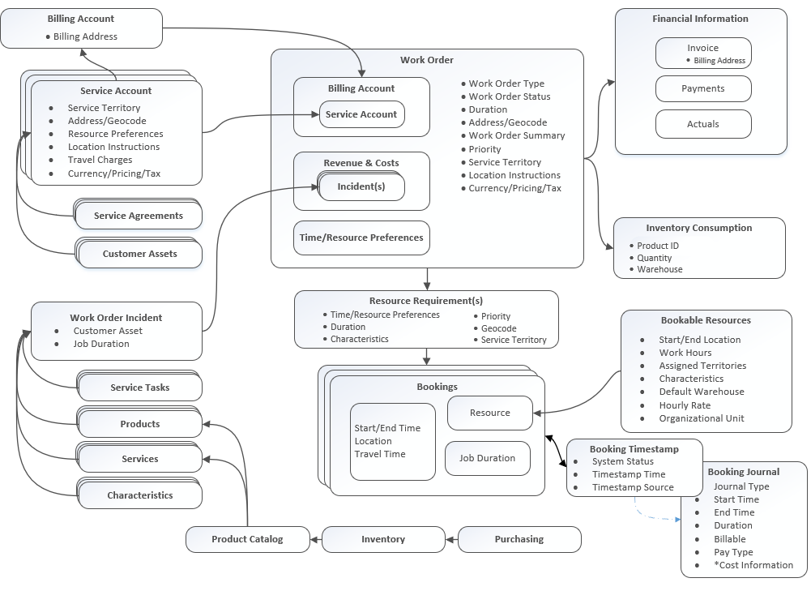
Field Service: Context Diagram
Provide information on notable ways that your field service application designs differ from the standard model.
Notes:
=========================
Why are we asking this information?
This field service context diagram depicts the core field service app data model, including key attributes, and entity relationship structure. Discussing how your intended design maps to the out of the box data model, and process flows, will allow us to begin to understand the fit gap, document key findings, and offer relevant recommendations.
=========================
What we’ll do with this information?
With this information we will be able to determine whether the FastTrack Success by Design field service workshop is relevant as a next step.
=========================
FAQ:

Slide 55
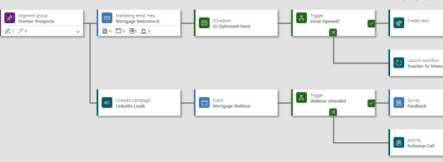
Marketing: Sample Processes
Use the customer journey or the existing diagrams to explain the end-to-end process
Notes:
=========================
Why are we asking this information?
This information is important to understand the end-to-end process of the Marketing lifecycle.
=========================
What we’ll do with this information?
Understand the complexity of the process and the features that are used.
=========================
FAQ:

Slide 56
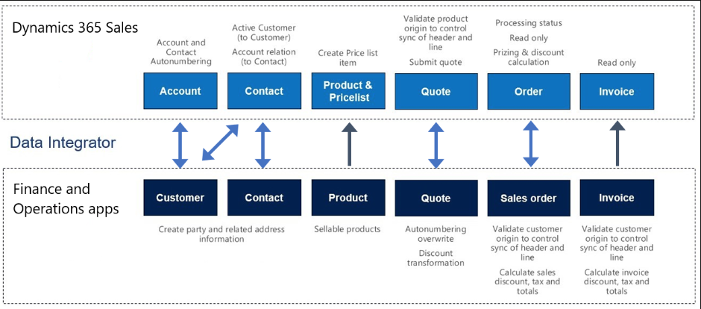
Prospect to Cash Data Flow
Notes:
=========================
Why are we asking this information?
This information is important to understand how the Resource Assignment will be done for the Project.
For Resource Assignment Process should provide details on how Resources will be assigned to the Project Tasks in a Project. Will they be directly assigned by the Project Manager or requested to a Request Manager? Will there be an Approval process for assignments?
For Time Entry and Expenses Approval should provide details on the submission and approval process. Will both be used? If not, will they be handled by another system? How?
=========================
What we’ll do with this information?
Understand whether there will be any customization done to the Resource Assignment Process.
=========================
FAQ:

Slide 57
On-Premises To Online (OP2OL) Migration
Important review areas
Clarity on all pre-requisites to support OP2OL
All steps/issues/time taken/owners captured in a well-defined runbook
All components that need to change for online identified, SQL Based Report, Full trust plugins etc. + findings from solution checker
Existing integrations identified and changes required to work in cloud
Deprecations identified, especially Unified interface, Soap, Client JS and work planned to address it
Online platform API limits/entitlements understood and accounted for CDS, Power Automate, Power Apps, especially for integrations and heavy batch processing
Service Protection limits taken into consideration with retry mechanisms for all integration
Plan to check performance in cloud as there can be impact due to n/w latency, device types etc.

Slide 58
Sales Application
Further understanding of how the Sales process, personas, Sales channels, key drivers for change
Key goals and drivers for change
Sales Business KPIs & Metrics impacted by Sales implementation
Typical Sales cycle time
Your Industry type and target customer’s industry and segment. (Ex: Software firm selling Travel solution to Large Airlines)
You sales motion B2C/B2B/Hybrid
Key Sales personas and profile (Ex: Inside Seller dealing with volume leads, Relationship seller, Sales managers.. etc)
Sales Channels used by your seller. (Ex: Phone, Chat, In person meetings .. Etc)
Key Geography Ex: Your customer are mostly in APAC
Seasonal Impact. (Ex: Retail around Christmas, important manufacturing events/trade shows)
Expected Insights and AI capabilities . (Ex: Need Opportunity Scoring, Relationship Analytics to meet KPIs )
Overall Yearly/monthly lead/opportunity volumes

Slide 59
Sales Application
Summarize Sales Collaboration Requirements
Quoting process
Account Planning needs and segment-based sales engagement model Which factors are key contributors to increased revenue and up-sell? (Ex. Quality of service provided, field service engineer being able to immediately quote on-site, or account manager relationship with key customer stakeholder)
Sellers's mobility expectations
How they envisage lead routing?
Potential need for integrated telephony
How does Sales operations / coaches work to steer sales?
How do they plan to forecast sales?
Seller expectations and asks? Ex. automated data entry, user experience, automated scoring – help prioritizing deals, driving efficiency
How is your data quality today? What are your plans to ensure high data quality in the future?

Slide 60
Dynamics 365 Sales & Sales Insights Sales & Sales Insights Capabilities Planned
Sales
execution
Sales collaboration
Guided
selling
Relationship selling
Velocity
selling
Sales performance
Sales Intelligence
Sales
Platform
Account and Contact Management
Lead and Opportunity Management
Order Management
Product Catalog
Activity Management
3rd party solution discovery
Outlook add-in
Microsoft Teams integration
SharePoint & OneDrive integration
Excel Integration
OneNote embedded
Co-authoring in Word & PowerPoint
Business Process Flows
Playbooks
Assistant cards
Power Automate
Assistant Studio*
Embedded Sales Navigator insights
Data synchronization
Insights based on Sales Navigator interactions
Who Knows Who*
Talking points*
Live org chart
Relationship Analytics*
Email Engagement
Sales accelerator (preview) *
Sequences* (preview)
Intelligent prioritization with predictive lead scoring*
Embedded Dialer support*
Conversation transcript & intelligence (preview) *
Kanban view
Reports and dashboards
Forecasting
Territory Management
Gamification
Power BI integration
Conversation intelligence*
Predictive forecasting *
Forecast snapshots and analysis*
Opportunity scoring *
Notes analysis*
Auto capture* (preview)
Predictive assistant cards*
Mobile applications
Workflows
Customizations
Power Apps
AI Builder
Data Integrations
Custom controls
Notes:
Before moving forward to new capabilities, I just wanted to remind folks about the breadth of scenarios that Dynamics 365 Sales already enables.
Dynamics 365 Sales comes with out of the box standard sales force automation capabilities such as account and contact management, lead and opportunity management and activity management.
Those capabilities are reinforced by deep collaboration integrations with Microsoft Teams for internal communication. Outlook add-in for external communication and SharePoint for document management.
Guided selling is one of our strong suit, supported by visual Business processes Flows, automated activities with playbooks and even customizable assistant cards powered by Power Automate for just in time next best actions.
Integrations with Exchange and LinkedIn, ensure that sellers can accurately engage, manage and nurture their relationship with customers and stakeholders.
With forecasting and powerbi integration, organizations can manage the performance of their teams and take the necessary actions from the insights derived from reports and dashboards.
These core sales scenarios are further enhanced by intelligent and AI driven capabilities such as predictive scoring models for lead and opportunity prioritization, notes analysis for transforming unstructured data into structured data and auto-capture for streamlining the capture of activities and contacts in Dynamics.
And finally, Dynamics 365 is built on the Power Platform an extensible framework for enhancing the system to meet any company need.

Slide 61
Sales process Summary
Describe your sales process, Lead, opportunity, quote etc
Lead handover from Marketing
Create an Opportunity
Opportunity Approval
Send Quote
Accept Quote
Close as Won
Create a project

Slide 62
Instructions for FastTrack Solution Architect
Purpose: Attached slide deck supplements the existing SBR Workshop template for Healthcare Implementations. The following instructions explains and what slides from original SBR needs to be replaced or updated.
Start with the FastTrack SBR Workshop Template
Replace the FastTrack SBR workshop template with the appropriate slides from this deck where appropriate.
Share the final SBR template with Customer and Partner for workshop
Confirm the customer has reviewed Healthcare learning resources on MS Learn and the Cloud for Healthcare FastTrack Tech Talks
Confirm if the partner has attended instructor-led Cloud for Healthcare trainings, including Healthcare APIs training

Slide 63
Program Strategy - Solution Scope
Example – Please update as appropriate
Main Functional Areas
Patient Access
Patient Service Center
Care Management
Home Health
Patient Outreach
Virtual Visits
Azure FHIR Sync Agent
Phase & Timeline
Project start: August 2016
Current Project Phase: Design
Target go-live: January 2017
Number of users: 185
Business
Industry: Manufacturing
Business Model: B2B vs B2C
Geos: US and Canada
Default Language: EN-US
Default Currency: USD
Data Center: US East
185
Total User Count
2
Geos
3
Project Phases
6
Integrations internal/external
1/4
Total Tenants/ Environments
1
ISV solutions

Slide 64
Program Strategy - Solution Scope
Example – Please update as appropriate
Please indicate which Microsoft Cloud for Healthcare solutions are being implemented?
Healthcare Solutions | Dependencies | Indicate Yes/No
Patient Service Center | Dynamics 365 Customer Service Digital Messaging add-in for Dynamics 365Customer service
Patient Outreach | Dynamics 365 Marketing
Patient Access | Power Apps Portal Dynamics 365 Customer Service
Care Management | -
Home Health | Dynamics 365 Field Service
Virtual Visits | Microsoft Teams

Slide 65
Program Strategy - Solution Scope
Example – Please update as appropriate
External Systems & FHIR Resources
Are you planning to get the data from an existing EHR/EMR system? If so, please provide the name(s).
Are you planning to use Azure API for FHIR? If so, will you use the FHIR Sync Agent?
Are you planning to use Azure API for FHIR for business requirements, outside of integration with Dataverse?
In what format will you be sending data to Azure API for FHIR?
Are you going to send data from Dataverse to your EHR/EMR?

Slide 66
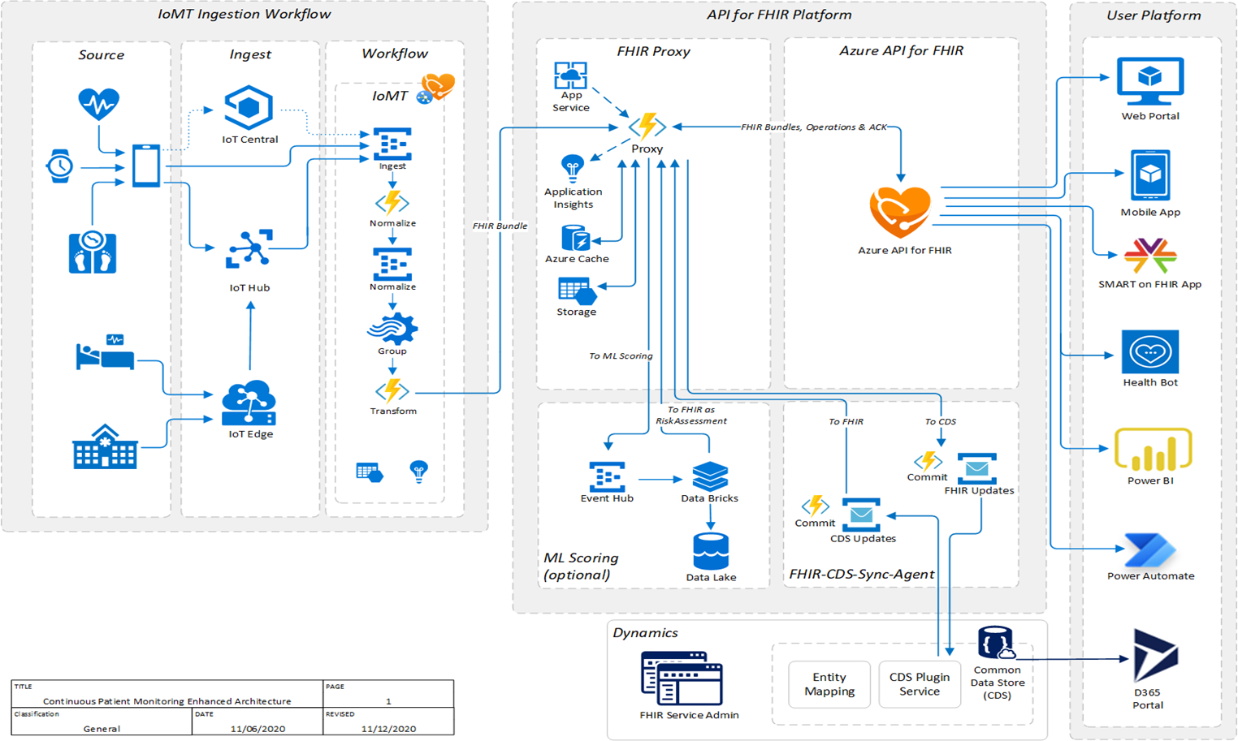
App Strategy - Solution Architecture
Example – Please update as appropriate
Blueprint, architecture diagrams, functional overview…
A blueprint that provides a conceptual view of the architecture being built
The view should cover system landscape and key interfaces, such as integrations with other systems

Slide 67
App Strategy - Solution Architecture
Example – Please update as appropriate
Describe your Solution Architecture
Please describe your solution architecture here. For example, if you are planning on using Azure API for FHIR and planning on bringing EHR/EMR to Azure API for FHIR; please describe the process. [Add additional slides as needed]

Slide 68
Reporting and BI
Example – Please update as appropriate
Please describe reporting and analytics requirements
Describe your reporting requirements & architecture.
Will you be leveraging any of the native Power BI reports for Cloud for Healthcare?

Slide 69
Appendix

Slide 70
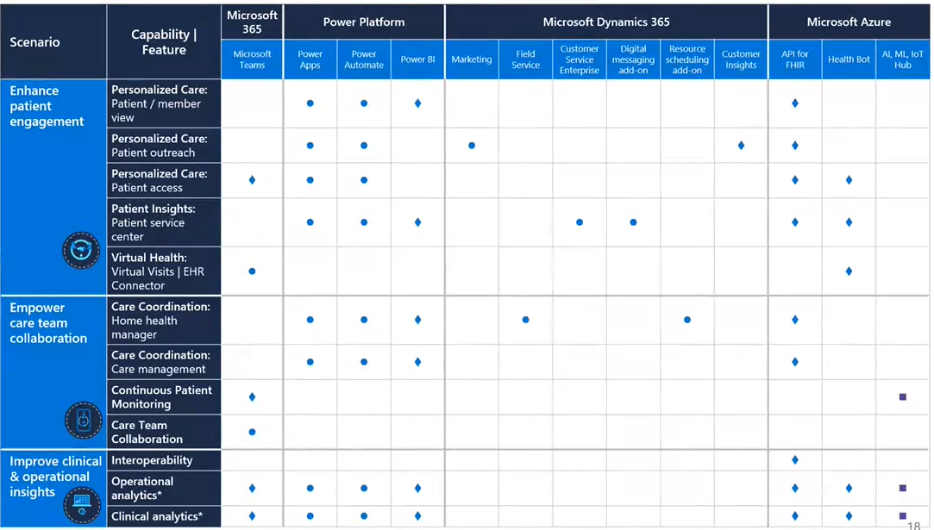
Microsoft Cloud for Healthcare

